Slide 1
TV in Germany

Slide 2
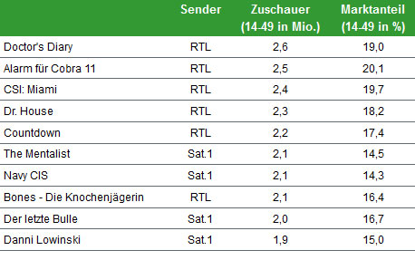
. Here's what we liked to watch in Germany in 2011.

