Slide 1
Parables
English 12

Slide 2

What is a parable?
The word "parable" comes from the Greek word παραβολη parabolee. In the Greek para means beside, and ballo means to cast or throw. So parable means to cast beside.

Slide 3

Parable
Parable means to cast a familiar idea beside an unfamiliar idea in such a way that the comparison helps people to better understand and grasp the unfamiliar idea.

Slide 4

Parables
A simple story is told, certain features of which are analogous or parallel to the points or principles one wishes to drive home.

Slide 5

How Does a Parable Work?
Who tells parables? Where do we most hear them?
All cultures and all countries use parables.

Slide 6

How to interpret a parable
It is important to understand that in a parable there are certain features that carry the moral or point.
Other details are there simply to make the story vivid, memorable, and complete in the mind's eye of the hearer.
We should interpret the parables according to the simple principles they are meant to teach.

Slide 7

What is a parable?
It was the style of teaching of the day.

Slide 8

What is a parable?
Parables make teachings easier to remember and apply.

Slide 9

What is a parable?
Parables are more enduring than telling it like it is.

Slide 10

What is a parable?
If the situation changes, “telling it like it was” becomes irrelevant, but the parable lives on.

Slide 11
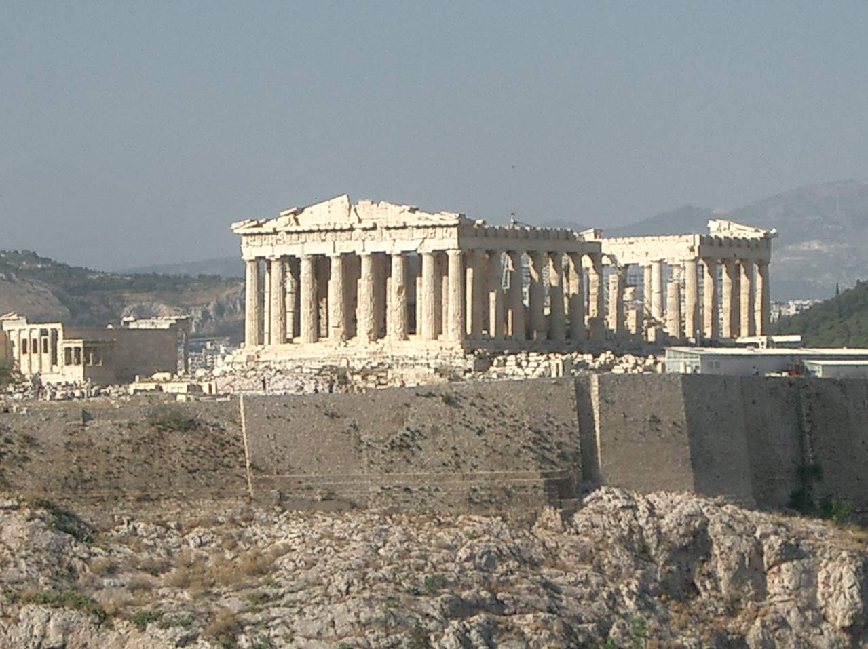
What is a parable?
Parables have a time-release effect; they plant seeds that sprout later.

Slide 12

What is a parable?
Parables allow you to make statements that would otherwise get you in trouble.

Slide 13
Writing a parable
Step 1
Write or type out the moral of the story. If the spiritual or religious lesson is already written in parable form, read the parable and extract the meaning from it. This will be your starting point, or the foundation of your parable.

Slide 14

Writing a parable
Step 2
Know your audience. Who are you writing the parable for? Do you want to reach children, teens or adults? Do you want your parable to reach all people, or just to a specific group? Knowing this will help you develop a story that is appropriate for your audience.

Slide 15
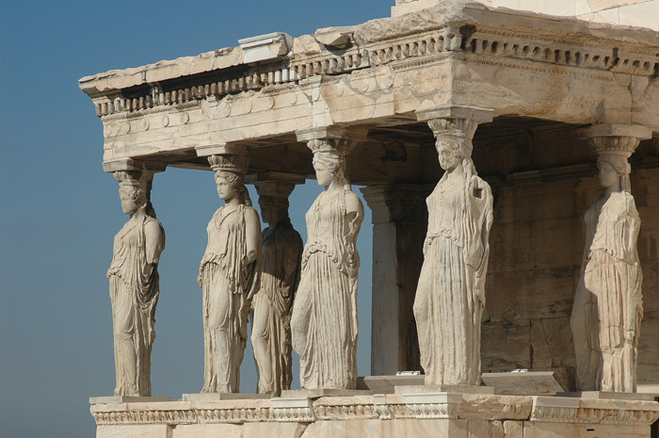
Writing a parable
Step 3
Spend some time brainstorming. If you have a spiritual concept, such as "we are all connected," think of ways that you see that in your day-to-day life. How do you, yourself, understand the concept or lesson that you want to develop into a story? Think of ways that you've received the lesson in your life. Nature is a great teacher of many spiritual lessons.

Slide 16
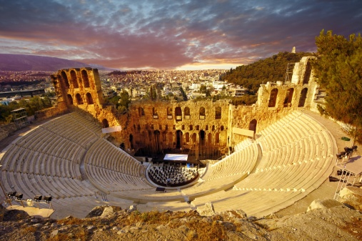
Writing a parable
Step 4
Develop your story. Keep it simple. The characters don't have to be actual people. You can use nature or animals to tell the story, if you wish. Be creative. Also, you can illustrate the story by using dialog between two people. Recall a time when you were given a lesson by another person. How did they reveal the story to you? What was the dialog like between you? See if you can re-create it in the story.

Slide 17
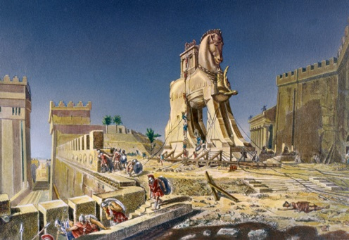
Writing a parable
Step 5
Parables are more effective when written short. Tell your story in 400 words or less.

Slide 18

Writing a parable
Step 6
After you are done with your story, have someone read it. Does it make your reader inspired, or think a different way? Inspiration is key to a great parable.

