Slide 1
Eine and ein: indefinite articles
Deutsch I Kapitel 3-1

Slide 2
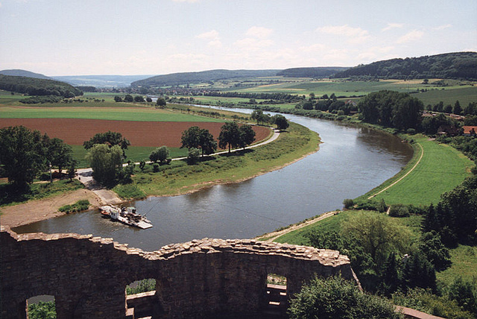
What are articles?
The words that come in front of nouns are called articles.

Slide 3
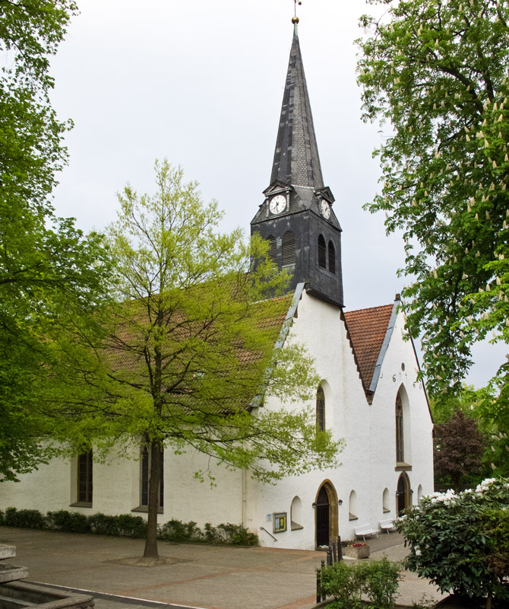
What are articles?
There are two kinds of articles:
Definite
Indefinite

Slide 4
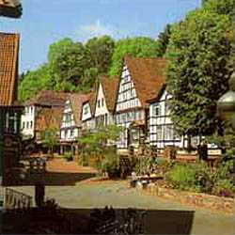
What are definite articles?
Definite articles are words like der, die, and das.
In English that would be the.
They are called definite articles because they refer to a very definite noun.
The blouse is blue.
The book is new.

Slide 5
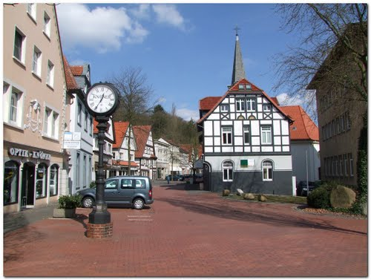
What are indefinite articles?
In English the indefinite articles are a or an.
These articles come before nouns that don’t have a special object in mind.
A blouse is nice.
A book would be good.

Slide 6
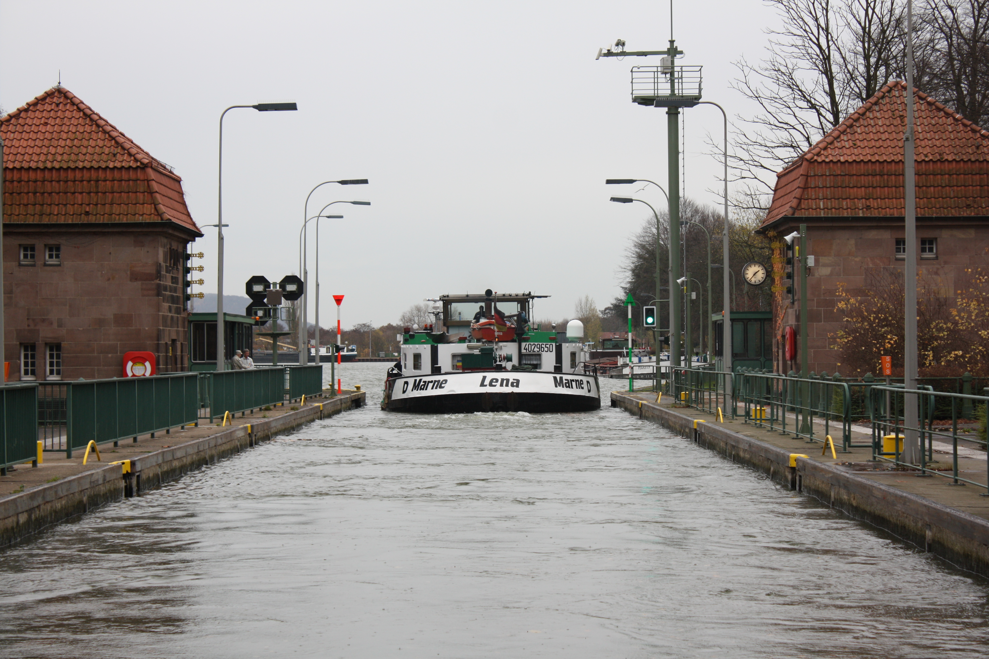
What are indefinite articles?
In German, it is ein or eine.

Slide 7
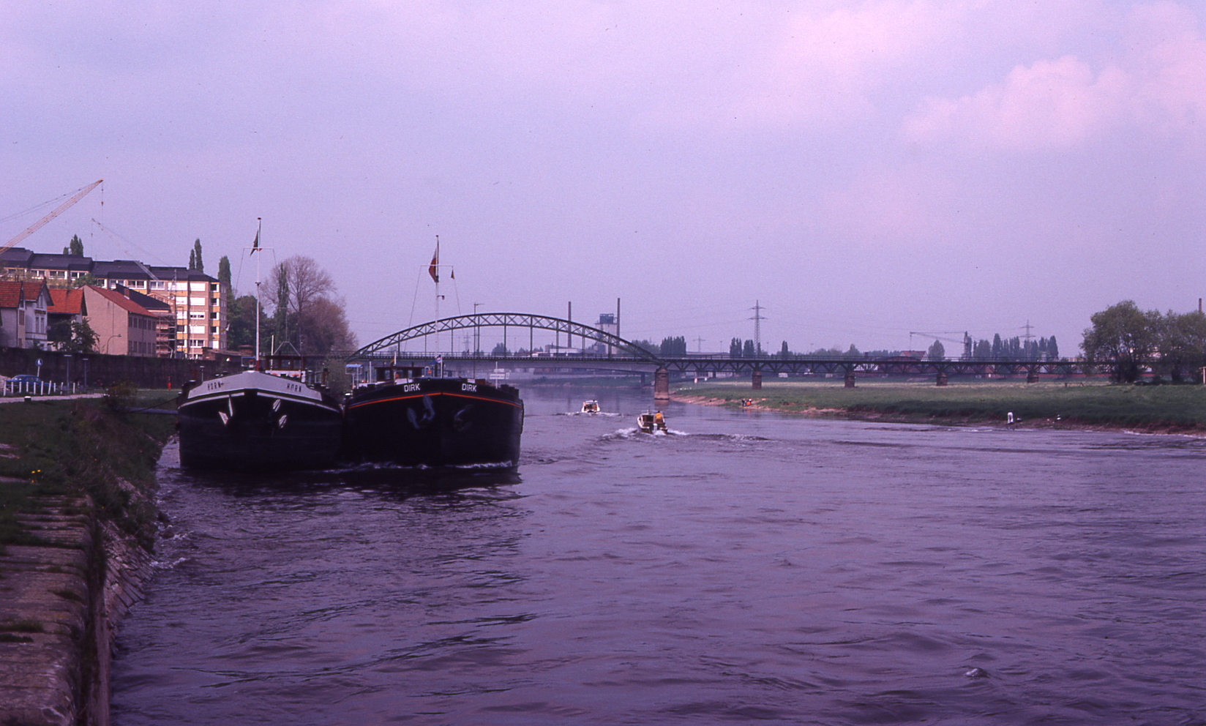
Articles
 | Nominative | Accusative | Dative
Masculine | ein
Feminine | eine
neuter | ein

